Slide 1
THE VISUAL CLASSROOM • DAA
PRIM’S
ALGORITHM
B
D
4
2
A
1
2
5
3
Minimum Spanning Tree using
a Greedy Strategy
E
C
6
DESIGN & ANALYSIS OF ALGORITHMS
Presentation
WEIGHTED • UNDIRECTED • CONNECTED
DESIGN & ANALYSIS OF ALGORITHMS • PRIM’S ALGORITHM
01

Slide 2
02 / DAA PROJECT
The Problem
Find the cheapest way to connect every vertex — without cycles.
B
D
4
THE GOAL
2
Connect all vertices
A
1
5
2
Minimum total edge weight
3
No cycles
C
6
E
MST contains V − 1 edges
V = 5
E = 7
START = A
DESIGN & ANALYSIS OF ALGORITHMS • PRIM’S ALGORITHM
02

Slide 3
03 / DAA PROJECT
Minimum Spanning Tree
The selected edges form one connected tree.
B
4
D
2
SPANNING
MINIMUM
All vertices
connected
Lowest total
weight
A
2
1
5
3
TREE
TARGET
C
E
No cycles
V − 1 = 4 edges
6
MST = connected + minimum + cycle-free
DESIGN & ANALYSIS OF ALGORITHMS • PRIM’S ALGORITHM
03

Slide 4
04 / DAA PROJECT
Given Graph
One example. Seven weighted edges. Start at A.
B
4
D
2
VERTICES
A, B, C, D, E
A
1
2
EDGE LIST
5
A–B 2 A–C 3
B–C 1 B–D 4
C–D 5 D–E 2
C–E 6
3
C
E
6
GOAL
Connect all vertices at minimum cost.
DESIGN & ANALYSIS OF ALGORITHMS • PRIM’S ALGORITHM
04

Slide 5
05 / DAA PROJECT
How Prim’s Algorithm Works
At each step, add the cheapest safe edge from the current tree.
01
02
03
04
START
→
FRONTIER
→
GREEDY CHOICE
→
EXPAND
Begin at A
Check edges leaving the tree
Pick the lightest crossing edge
Add the new vertex
B
D
2
4
A
FIRST FRONTIER FROM A
1
2
A–B = 2
A–C = 3
5
3
C
6
E
Choose A–B first.
DESIGN & ANALYSIS OF ALGORITHMS • PRIM’S ALGORITHM
05

Slide 6
06 / DAA PROJECT
Expand {A}
Teal = selected tree • Orange dashed = current candidates
B
4
D
2
01
A
Choose A–B
1
5
2
weight 2
3
Lightest crossing edge
C
E
6
DESIGN & ANALYSIS OF ALGORITHMS • PRIM’S ALGORITHM
06

Slide 7
07 / DAA PROJECT
Update after B joins
Teal = selected tree • Orange dashed = current candidates
B
4
D
2
02
A
2
1
Choose B–C
5
weight 1
3
Weight 1 reaches C
C
E
6
DESIGN & ANALYSIS OF ALGORITHMS • PRIM’S ALGORITHM
07

Slide 8
08 / DAA PROJECT
Update after C joins
Teal = selected tree • Orange dashed = current candidates
B
4
D
2
03
A
Choose B–D
1
2
5
weight 4
3
Cheaper than C–D
C
E
6
DESIGN & ANALYSIS OF ALGORITHMS • PRIM’S ALGORITHM
08

Slide 9
09 / DAA PROJECT
Complete the Tree
Teal = selected tree • Orange dashed = current candidates
B
4
D
2
04
A
1
2
Choose D–E
5
weight 2
3
All five vertices are connected.
C
E
6
MST COST = 2 + 1 + 4 + 2 = 9
4 SELECTED EDGES
DESIGN & ANALYSIS OF ALGORITHMS • PRIM’S ALGORITHM
09

Slide 10
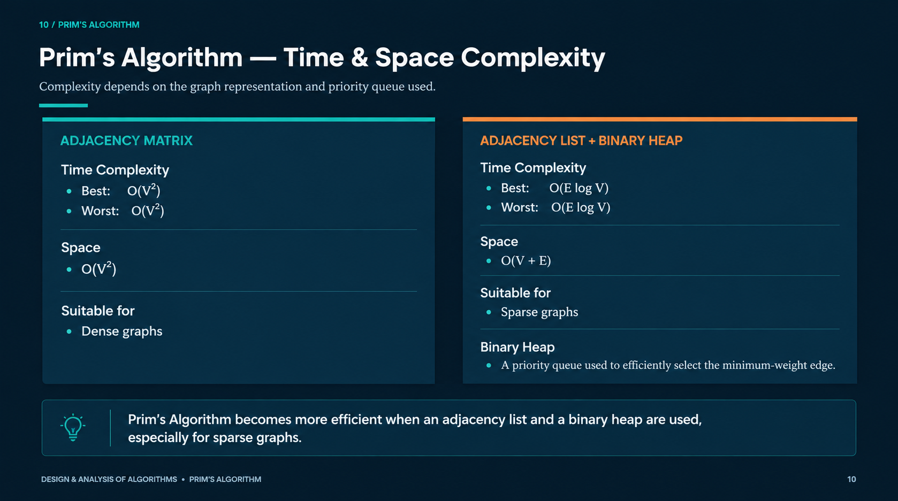
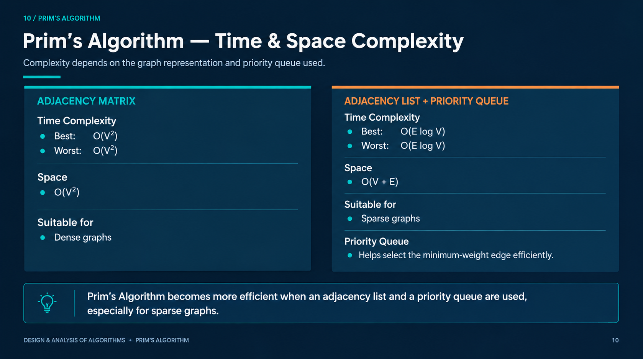
10 / DAA PROJECT
Data Structures Change the Cost
The representation determines the running time.
ADJACENCY MATRIX
ADJACENCY LIST + BINARY HEAP
O(V²)
Space: O(V²)
O((V + E) log V)
Space: O(V + E)
Simple scan
Efficient for sparse graphs
DESIGN & ANALYSIS OF ALGORITHMS • PRIM’S ALGORITHM
10

Slide 11
11 / DAA PROJECT
Same Destination. Different Route.
Both algorithms find a minimum spanning tree.
PRIM’S
KRUSKAL’S
Grows one connected tree
Chooses cheapest crossing edge
Priority Queue + adjacency structure
Good for graph-growth view
Builds a forest of components
Chooses globally lightest safe edge
Edge sort + Disjoint Set
Good for edge-list view
DESIGN & ANALYSIS OF ALGORITHMS • PRIM’S ALGORITHM
11

Slide 12
12 / CONCLUSION
Grow. Choose.
Connect.
FINAL MST COST
9
Prim’s algorithm grows an MST through safe greedy choices.
4 selected edges
B
4
D
2
Each step adds the cheapest useful connection.
A
1
2
For the given graph, MST cost = 9.
5
3
C
6
E
THANK YOU
DESIGN & ANALYSIS OF ALGORITHMS • PRIM’S ALGORITHM
12

